Slide 1
Unsupervised Machine Learning

Slide 2
What is Unsupervised Machine Learning
Unsupervised Learning is a machine learning technique in which the users do not need to supervise the model. Instead, it allows the model to work on its own to discover patterns and information that was previously undetected.
It mainly deals with the unlabelled data.
Unsupervised learning cannot be directly applied to a regression or classification problem because unlike supervised learning, we have the input data but no corresponding output data. The goal of unsupervised learning is to find the underlying structure of dataset, group that data according to similarities, and represent that dataset in a compressed format.

Slide 3
Why we use it?
Unsupervised machine learning finds all kind of unknown patterns in data.
Unsupervised methods help you to find features which can be useful for categorization.
It is taken place in real time, so all the input data to be analyzed and labeled in the presence of learners.
It is easier to get unlabeled data from a computer than labeled data, which needs manual intervention.

Slide 4
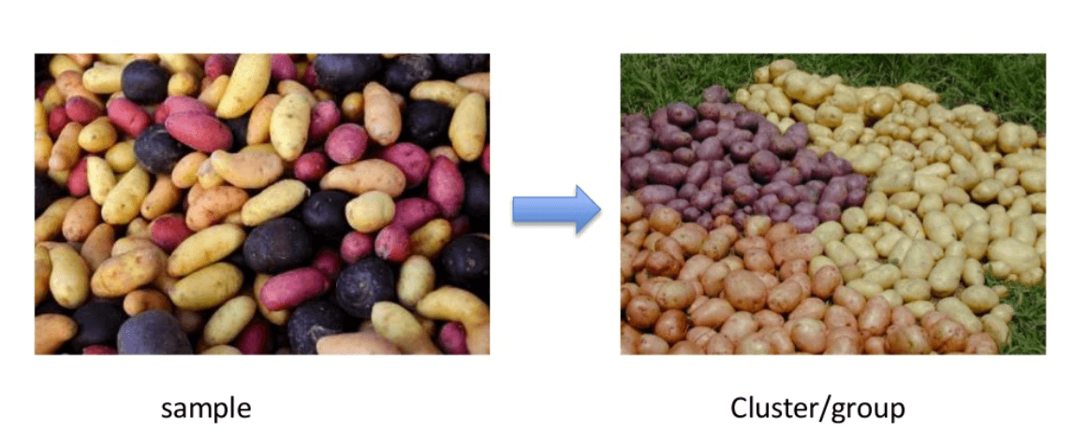

Slide 5
Clustering
It mainly deals with finding a structure or pattern in a collection of uncategorized data. Unsupervised Learning Clustering algorithms will process your data and find natural clusters(groups) if they exist in the data.
We can also modify how many clusters your algorithms should identify. It allows you to adjust the granularity of these groups.

Slide 6
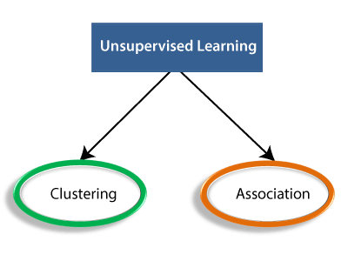
Types of Unsupervised Learning Algorithm:

Slide 7
Clustering: Clustering is a method of grouping the objects into clusters such that objects with most similarities remains into a group and has less or no similarities with the objects of another group. Cluster analysis finds the commonalities between the data objects and categorizes them as per the presence and absence of those commonalities.
Association: An association rule is an unsupervised learning method which is used for finding the relationships between variables in the large database. It determines the set of items that occurs together in the dataset. Association rule makes marketing strategy more effective. Such as people who buy X item (suppose a bread) are also tend to purchase Y (Butter/Jam) item. A typical example of Association rule is Market Basket Analysis.

Slide 8
Examples
Clustering:
spam detection, sentiment analysis, scorecard prediction of exams.
Association :
Movie recommendation in Netflix
Product recommendation in Amazon

Slide 9
Unsupervised Learning algorithms:
K-means clustering
KNN (k-nearest neighbors)
Hierarchal clustering
DBSCAN clustering
Anomaly detection
Neural Networks
Principle Component Analysis
Independent Component Analysis
Apriori algorithm
Singular value decomposition

Slide 10
Advantages of Unsupervised Learning
Unsupervised learning is used for more complex tasks as compared to supervised learning because, in unsupervised learning, we don't have labeled input data.
Unsupervised learning is preferable as it is easy to get unlabeled data in comparison to labeled data.
Disadvantages of Unsupervised Learning
Unsupervised learning is intrinsically more difficult than supervised learning as it does not have corresponding output.
The result of the unsupervised learning algorithm might be less accurate as input data is not labeled, and algorithms do not know the exact output in advance.

Slide 11
Silhouette Score
Fowlkes Mallows Score
Adjusted Rand Index

Slide 12
The Silhouette Score attempts to describe how similar a datapoint is to other datapoints in its cluster, relative to datapoints not in its cluster (this is aggregated over all datapoints to get the score for an overall clustering).
In other words, it is about how ‘distinct’ the clusters are in space and indeed one could use any measure of ‘distance’ to calculate the score.
The score lies between –1 to 1.

Slide 13
K-Means clustering
K- Means is used for handling unsupervised ML problem.
It is one of the most famous algo.
Used in Customer Segmentation , Document Clustering , Recommendation Engines etc.

Slide 14
How K-Means works
Number of clusters (K): The number of clusters you want to group your data points into, has to be predefined.
Initial Values/ Seeds: The choice of the initial cluster centers can have an impact on the final cluster formation. The K-means algorithm is non-deterministic. This means that the outcome of clustering can be different each time the algorithm is run, even on the same data set.
Outliers: Cluster formation is very sensitive to the presence of outliers. Outliers pull the cluster towards itself, thus affecting optimal cluster formation.
Distance Measures: Using different distance measures (used to calculate the distance between a data point and cluster center) might yield different clusters.
The K-Means algorithm does not work with categorical data.
Inertia: Sum of squared distances of samples to their closest cluster center.

Slide 15
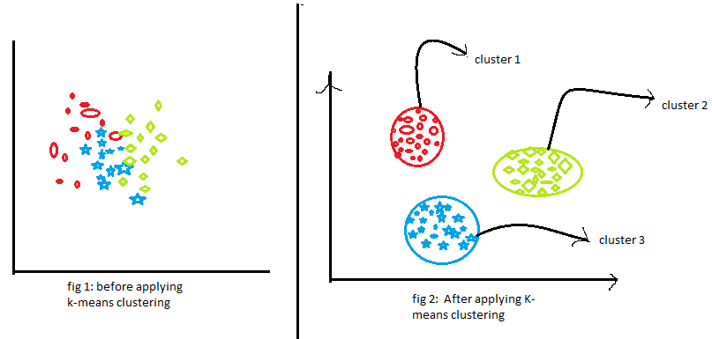

Slide 16
Steps
Step 1: Choose the number of clusters k
The first step in k-means is to pick the number of clusters, k.
Step 2: Select k random points from the data as centroids
Next, we randomly select the centroid for each cluster. Let’s say we want to have 2 clusters, so k is equal to 2 here. We then randomly select the centroid:
Step 3: Assign all the points to the closest cluster centroid
Once we have initialized the centroids, we assign each point to the closest cluster centroid:

Slide 17
Step 4: Recompute the centroids of newly formed clusters
Now, once we have assigned all of the points to either cluster, the next step is to compute the centroids of newly formed clusters:
Step 5: Repeat steps 3 and 4
We then repeat steps 3 and 4:

Slide 18
Why k-Means can’t be used for Categorical features?
The idea behind the k-Means clustering algorithm is to find k-centroid points and every point in the dataset will belong to either of the k-sets having minimum Euclidean distance.
The k-Means algorithm is not applicable to categorical data, as categorical variables are discrete and do not have any natural origin. So computing euclidean distance for such as space is not meaningful.
There is a certain variation to the k-Means algorithm, called k-Modes which is suitable for data with categorical features. k-Prototype is an extension of the k-Modes algorithm that works for mixed categorical and numerical features.

Slide 19
DBSCAN
DBSCAN stands for density-based spatial clustering of applications with noise. It is able to find arbitrary shaped clusters and clusters with noise (i.e. outliers).
The main idea behind DBSCAN is that a point belongs to a cluster if it is close to many points from that cluster.
There are two key parameters of DBSCAN:
eps: The distance that specifies the neighborhoods. Two points are considered to be neighbors if the distance between them are less than or equal to eps.
minPts: Minimum number of data points to define a cluster.

Slide 20
Based on these two parameters, points are classified as core point, border point, or outlier:
Core point: A point is a core point if there are at least minPts number of points (including the point itself) in its surrounding area with radius eps.
Border point: A point is a border point if it is reachable from a core point and there are less than minPts number of points within its surrounding area.
Outlier: A point is an outlier if it is not a core point and not reachable from any core points.

Slide 21
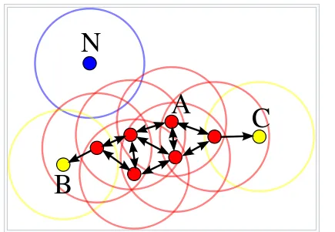

Slide 22
Pros and Cons of DBSCAN
Pros:
Does not require to specify number of clusters beforehand.
Performs well with arbitrary shapes clusters.
DBSCAN is robust to outliers and able to detect the outliers.
Cons:
In some cases, determining an appropriate distance of neighborhood (eps) is not easy and it requires domain knowledge.
If clusters are very different in terms of in-cluster densities, DBSCAN is not well suited to define clusters. The characteristics of clusters are defined by the combination of eps-minPts parameters. Since we pass in one eps-minPts combination to the algorithm, it cannot generalize well to clusters with much different densities.

Slide 23
Hierarchical Clustering
Hierarchical clustering is a popular method for grouping objects. It creates groups so that objects within a group are similar to each other and different from objects in other groups. Clusters are visually represented in a hierarchical tree called a dendrogram.
Hierarchical clustering has a couple of key benefits:
There is no need to pre-specify the number of clusters. Instead, the dendrogram can be cut at the appropriate level to obtain the desired number of clusters.
Data is easily summarized/organized into a hierarchy using dendrograms. Dendrograms make it easy to examine and interpret clusters.

Slide 24
Hierarchical clustering is one of the popular and easy to understand clustering technique. This clustering technique is divided into two types:
Agglomerative :
It is the Bottom to Top approach for building hierarchy.
Divisive :
It is the Top to bottom approach for building hierarchy.

Slide 25
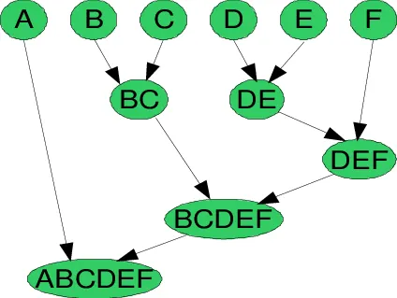
To understand better let’s see a pictorial representation of the Agglomerative Hierarchical clustering Technique. Lets say we have six data points {A,B,C,D,E,F}.
Step- 1: In the initial step, we calculate the proximity of individual points and consider all the six data points as individual clusters as shown in the image below.

Slide 26
Step- 2: In step two, similar clusters are merged together and formed as a single cluster. Let’s consider B,C, and D,E are similar clusters that are merged in step two. Now, we’re left with four clusters which are A, BC, DE, F.
Step- 3: We again calculate the proximity of new clusters and merge the similar clusters to form new clusters A, BC, DEF.
Step- 4: Calculate the proximity of the new clusters. The clusters DEF and BC are similar and merged together to form a new cluster. We’re now left with two clusters A, BCDEF.
Step- 5: Finally, all the clusters are merged together and form a single cluster.

Slide 27
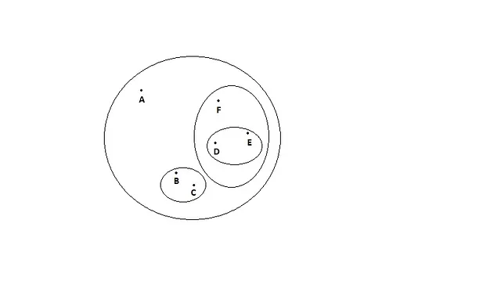
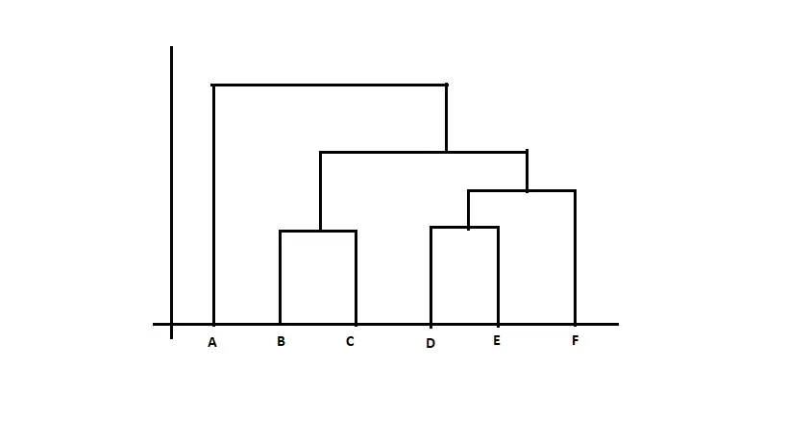
A Dendrogram is a tree-like diagram that records the sequences of merges or splits.

Slide 28
PCA
The Principal Component Analysis is a popular unsupervised learning technique for reducing the dimensionality of data. It increases interpretability yet, at the same time, it minimizes information loss. It helps to find the most significant features in a dataset and makes the data easy for plotting in 2D and 3D. PCA helps in finding a sequence of linear combinations of variables.

Slide 29
Advantages of PCA
Dimensionality reduction: By determining the most crucial features or components, PCA reduces the dimensionality of the data, which is one of its primary benefits. This can be helpful when the initial data contains a lot of variables and is therefore challenging to visualize or analyze.
Feature Extraction: PCA can also be used to derive new features or elements from the original data that might be more insightful or understandable than the original features. This is particularly helpful when the initial features are correlated or noisy.
Data visualization: By projecting the data onto the first few principal components, PCA can be used to visualize high-dimensional data in two or three dimensions. This can aid in locating data patterns or clusters that may not have been visible in the initial high-dimensional space.
Noise Reduction: By locating the underlying signal or pattern in the data, PCA can also be used to lessen the impacts of noise or measurement errors in the data.
Multicollinearity: When two or more variables are strongly correlated, there is multicollinearity in the data, which PCA can handle. PCA can lessen the impacts of multicollinearity on the analysis by identifying the most crucial features or components.

Slide 30
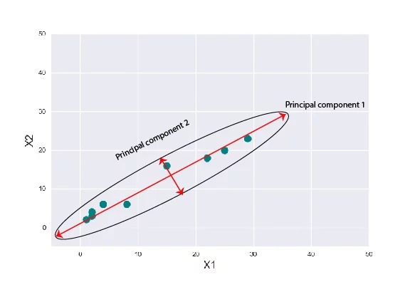

Slide 31
Steps To perform
Subtract the mean of each variable
Calculate the Covariance Matrix
Compute the Eigenvalues and Eigenvectors
Sort Eigenvalues in descending order
Select a subset from the rearranged Eigenvalue matrix
Transform the data

Slide 32
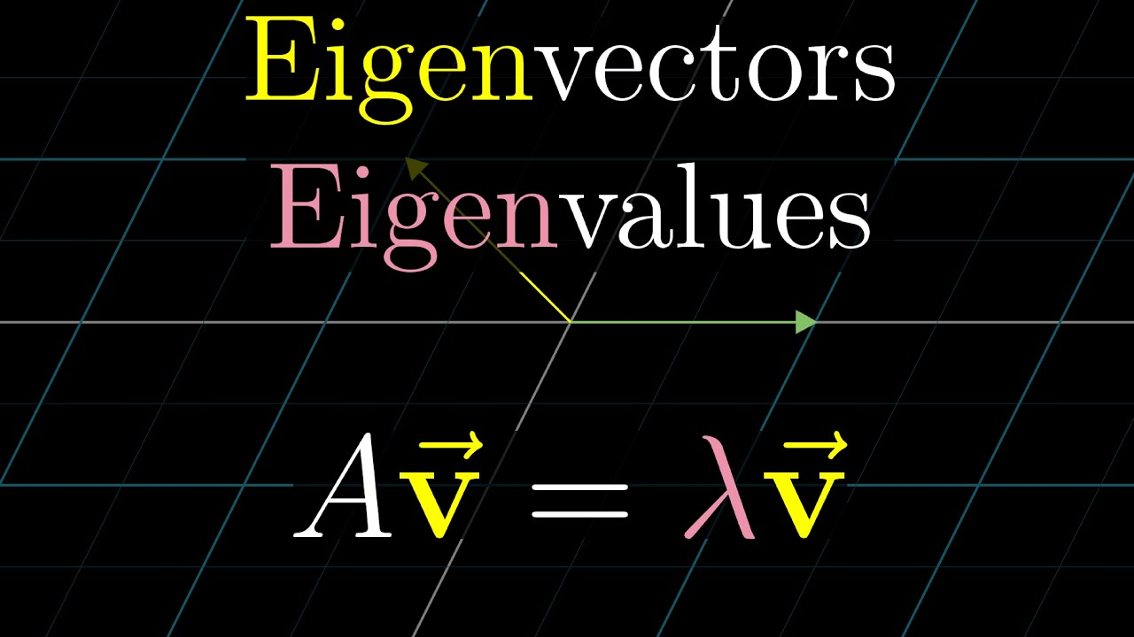

Slide 33
def PCA(X , num_components):
X_meaned = X - np.mean(X , axis = 0)
cov_mat = np.cov(X_meaned.T , rowvar = False)
eigen_values , eigen_vectors = np.linalg.eigh(cov_mat)
sorted_index = np.argsort(eigen_values)[::-1]
sorted_eigenvalue = eigen_values[sorted_index]
sorted_eigenvectors = eigen_vectors[:,sorted_index]
eigenvector_subset = sorted_eigenvectors[:,0:num_components]
X_reduced = np.dot(eigenvector_subset.transpose() , X_meaned.transpose() ).transpose()
return X_reduced

Slide 34
SVD(Singular Value decomposed)
The Singular Value Decomposition (SVD) of a matrix is a factorization of that matrix into three matrices. It has some interesting algebraic properties and conveys important geometrical and theoretical insights about linear transformations.
The Singular Value Decomposition of a matrix is a factorization of the matrix into three matrices. Thus, the singular value decomposition of matrix A can be expressed in terms of the factorization of A into the product of three matrices as A = UDV^{T}
Here, the columns of U and V are orthonormal, and the matrix D is diagonal with real positive entries.

Slide 35
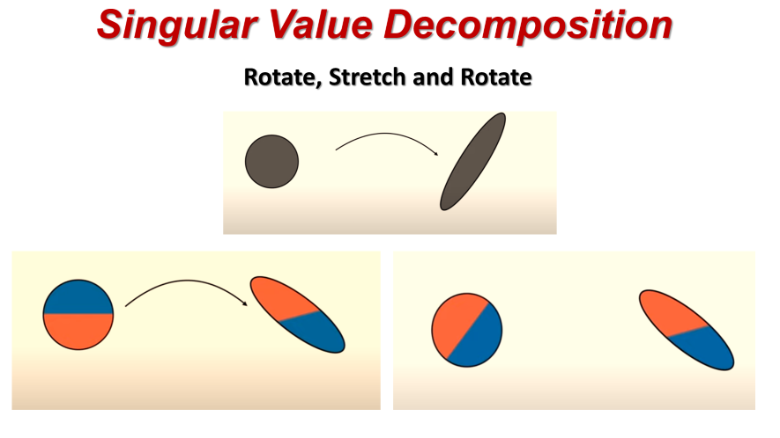

Slide 36
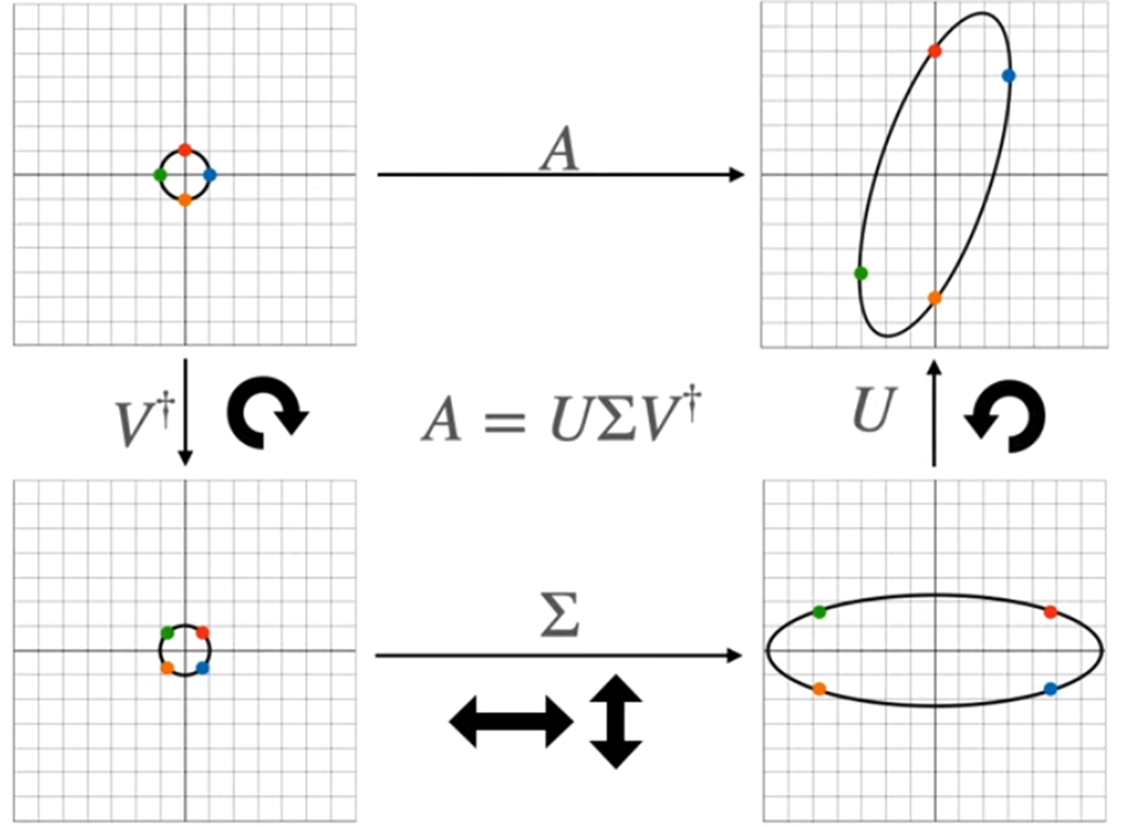

Slide 37
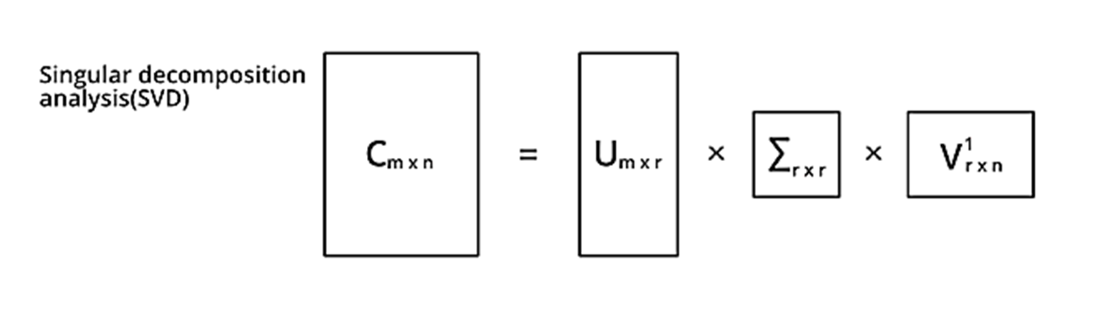
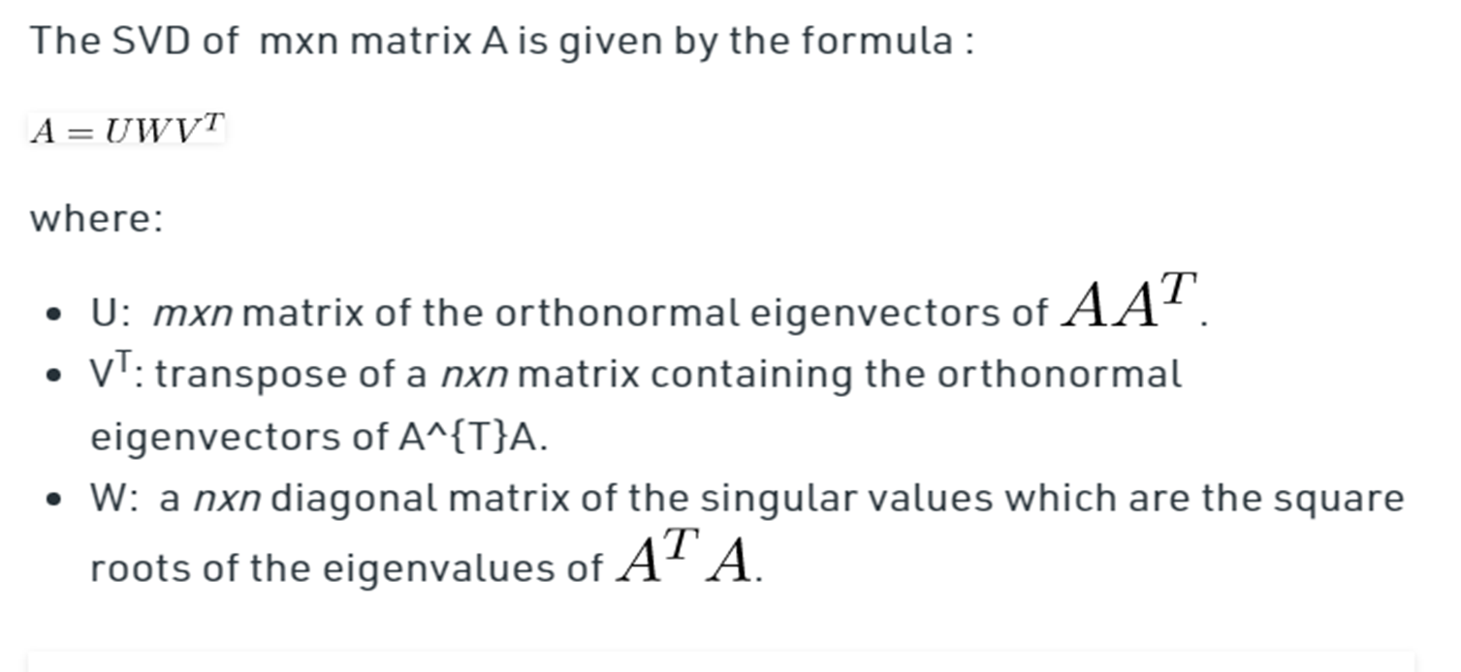

Slide 38
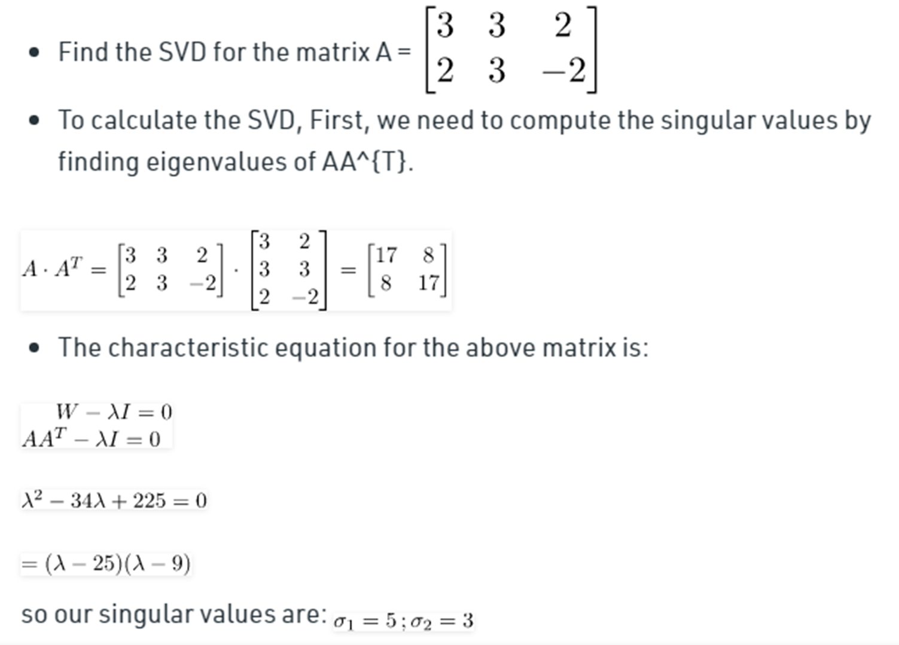
Example

Slide 39
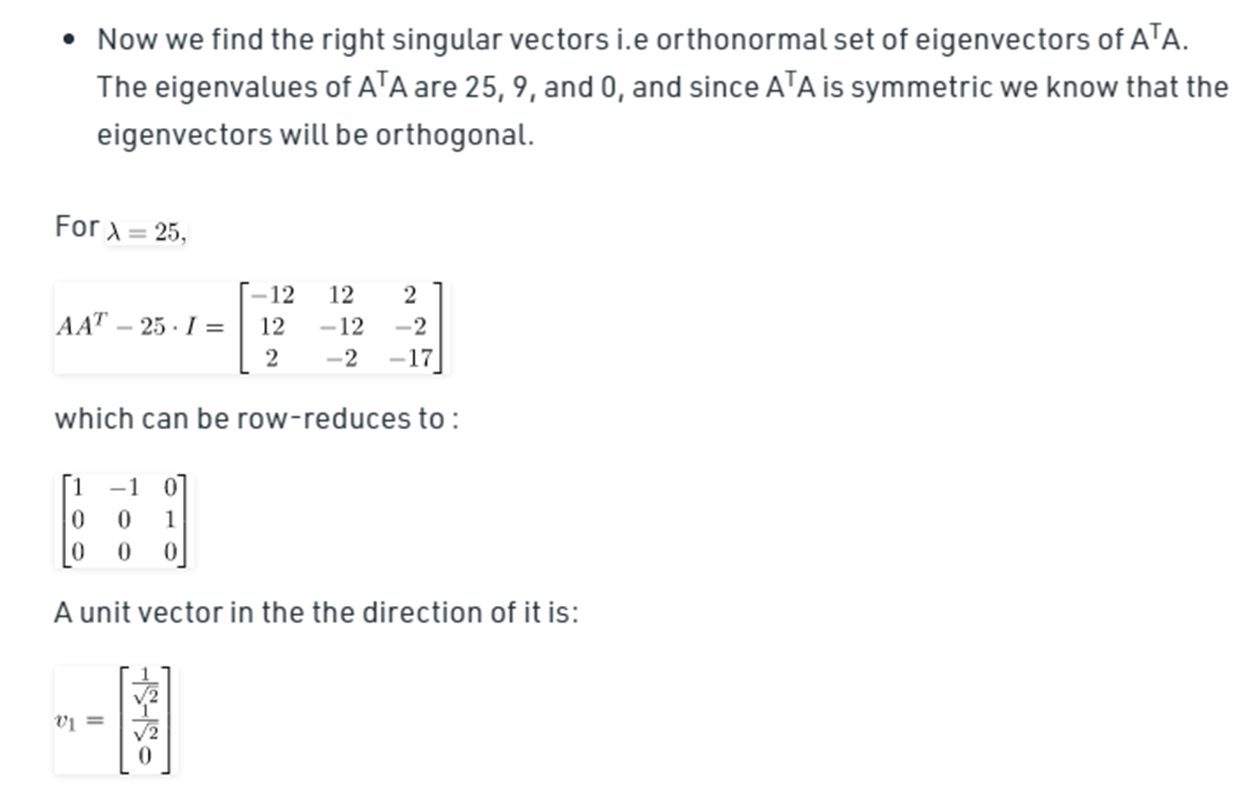

Slide 40
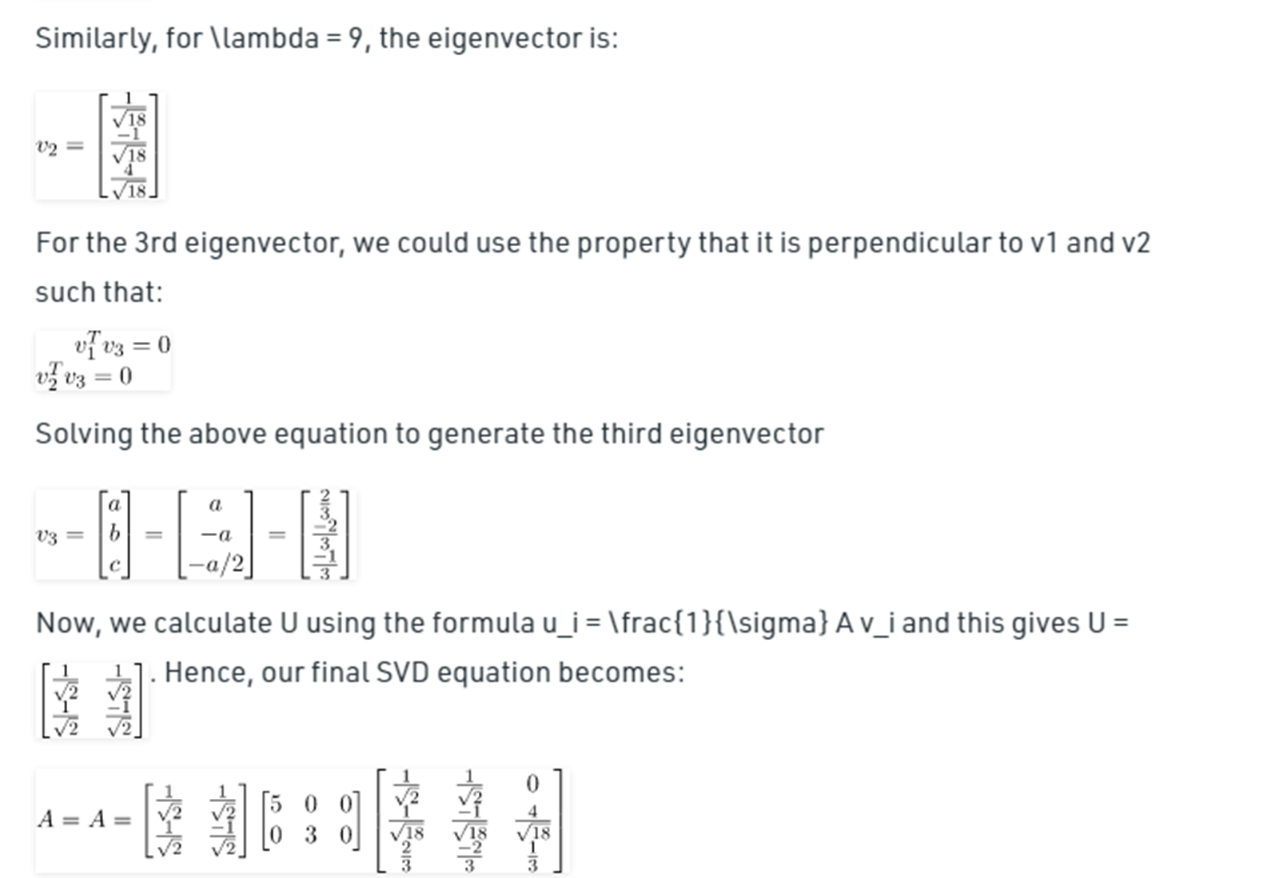

Slide 41
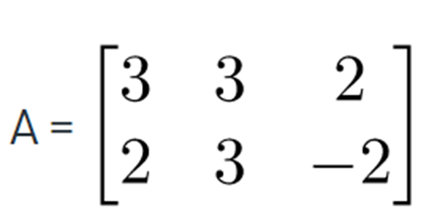
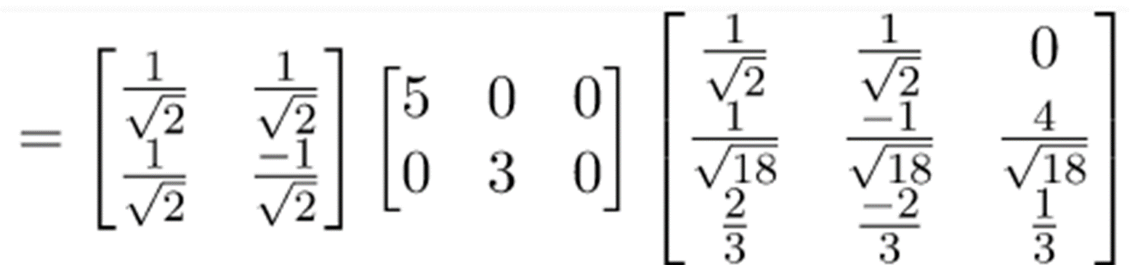
https://byjus.com/maths/singular-value-decomposition/

Slide 42
Application
•Image Compression
Image Recovery
Eigenfaces
Spectral Clustering
•Background Removal from Videos

